Slide 1



Sync 4 Collecting Metadata
UHC Summer Institute - June 29
Ran Li, Ms
Ana Ortigoza, MD PhD

Slide 2
Roadmap
Intro - Big Picture
Define FAIR meta(data)
Define FAIR meta(data)
Collect FAIR meta(data)
Utilize FAIR meta(data) + wrapping it all up in a DMP

Slide 3
Recap
Controlled Vocabulary:
standardized terms used to talk about concepts within a domain
Ontology:
Captures concepts and defines relationships between different types of data
RDF format :
Captures ontology in a machine actionable format

Slide 4
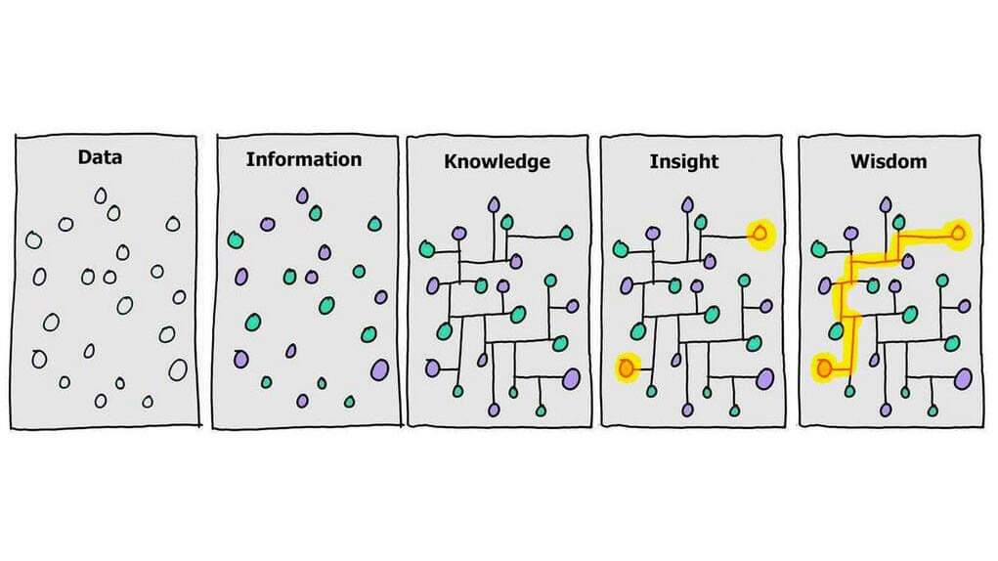
Recap
Ontology (Concepts, Relationships)
Metadata (.RDF)
Notes:
These specific tools place key roles within the FAIR process.
The first step is enriching your data with context and metadata. Note the key difference in the Netflix example we have just filled out metadata about the data (which is the actual digital content). We are giving context to the data. The next step is start thinking about this information in relationship to each other. Is this episode a part of a series? Is this movie a fantasy? In order to do that we need to define concepts (content, genre, series) and then the relationships between them. After all knowledge is building connections between pieces of information. So within ontology, we are extracting the knowledge in your head and model it in a way that is understandable by a compute so that I can start to automate things in a scalable and error-proof manner.
Whats the next

Slide 5
Whats next
Wrap up Ontologies
Sharing ontology
Meta(data) collection
Introduction to CEDAR

Slide 6
Ontology: Deployment to Bioportal
Why deposit onto a repository?
Findability
Accessibility
Interoperability/Integration
Reusability
Analytics
Netflix: https://bioportal.bioontology.org/ontologies/NETFLIX

Slide 7


Next: CollectION
FAIR
META(DATA)
COLLECTION TOOLS
Ontology (Concepts, Relationships)
Notes:
Now we have a controlled vocabulary and a clear map of the concepts within our projects stored in a way machines can understand. Whats next?
Instead of having a staff engineer build intake forms all over. There exists FAIR metadata collection tools tha tintegrat well with FAIR workflows (e.g. what we have been doing and depositing onto Bioportal). One of these tools is call CEDAR

Slide 8
CEDAR Workbench: FAIR TOOLING for metadata collection
FAIR Metadata
BioPortal Integration
Dynamic Templates
User-friendly
Interoperability
Open Source
https://cedar.metadatacenter.org/
Notes:
CEDAR, standing for the Center for Expanded Data Annotation and Retrieval, is an innovative toolset designed to simplify the process of creating metadata that align with FAIR principles. FAIR stands for Findable, Accessible, Interoperable, and Reusable - essential characteristics for ensuring data are effectively organized and shared in the scientific community. The purpose of CEDAR is to make FAIR data/metadata submission easier and faster so researchers can gather FAIR data and metadta. This sis done by provides well designed user itnerfaces using controlled terms and ontologies and apply analytics to speed up submission.
An important feature of the CEDAR Workbench is its integration with BioPortal, an extensive library of biomedical ontologies. By leveraging these ontologies, CEDAR helps create semantically rich metadata that are based on standard, shared concepts. This enhances the precision, interoperability, and usability of the metadata.
To simplify metadata entry and improve data consistency, CEDAR provides dynamic templates. These templates can adapt to different metadata needs, streamlining the process and ensuring accuracy and consistency in metadata creation.
Despite its powerful capabilities, the CEDAR Workbench is designed to be user-friendly and accessible to all users. Whether you're a seasoned data scientist or a researcher new to metadata, CEDAR's intuitive interface enables you to create high-quality, FAIR metadata with ease.
CEDAR's use of shared ontologies and standards promotes interoperability. Metadata created in CEDAR can be easily shared and understood by other systems, making data exchange and collaboration more effective and efficient.
Lastly, CEDAR is not just a tool, it's a community. As an open-source project, CEDAR's development is shaped by the feedback and needs of its users. This ensures that it continually evolves to provide the tools and capabilities that users truly need in their metadata creation tasks.

Slide 9
CEDAR 1: Find and navigate
Search bar or Workspace to search for CEDAR Artifacts
Types of CEDAR Artifacts
Templates = template of entire forms
Elements = sections within a Templates
Fields = individual questions within a element or template
Metadata = instances of forms
Notes:
Navigation
Search for ‘FAIR M4M` in the search bar and we see a lot of reponses.
We can filter by type of artifcats by using the etype filter.
We can also view as list format which makes this a lot of accessible
We see the folder we want to visit ‘GOFAIR M4M DeiC workshop’ and we double click to visiti it. The UI is loosely based on google docs. You can see the folder path at the top of the view and can view metadata about any of items listed by click ‘i’. This includes key metadta including versioning.
We can also navigate based on workspace. So content shared with me, shared with verbody or special folders
Types of CEDAR components
In CEDAR, an artifact refers to any creatable and manageable item within the workbench. These include templates, elements, fields, and metadata instances:
The CEDAR Workbench utilizes artifact to streamline the process of metadata creation. Here are explanations for each of the terms you mentioned:
Template: A template in CEDAR is a structure that describes what kind of information should be captured. It is essentially a form with different sections (elements) and fields where users can enter metadata. Templates provide an organized way to collect and standardize metadata across a dataset or study.
Element: Elements in CEDAR are reusable components that can be included in templates. They group together related fields. For example, you might have an element for "Author Information" that includes fields for name, affiliation, and contact information. This element could then be used in multiple templates.
Field: A field is the most granular component in a template. It is a single point of data entry where a specific piece of information should be captured. For example, a template might have fields for "Title," "Date," "Description," etc.
Metadata Instance: A metadata instance is a completed form (i.e., a filled-out template). It includes the actual metadata that has been entered into the fields defined by the template. This metadata describes a particular dataset or resource.
So, to summarize, you create a template with elements and fields to define what kind of metadata you want to collect. When you fill out this template with specific metadata, you create a metadata instance.
For example in this project: All / Shared / GOFAIR M4M DeiC Workshop / Demos and Examples
We can filter CEDAR components that we see

Slide 10
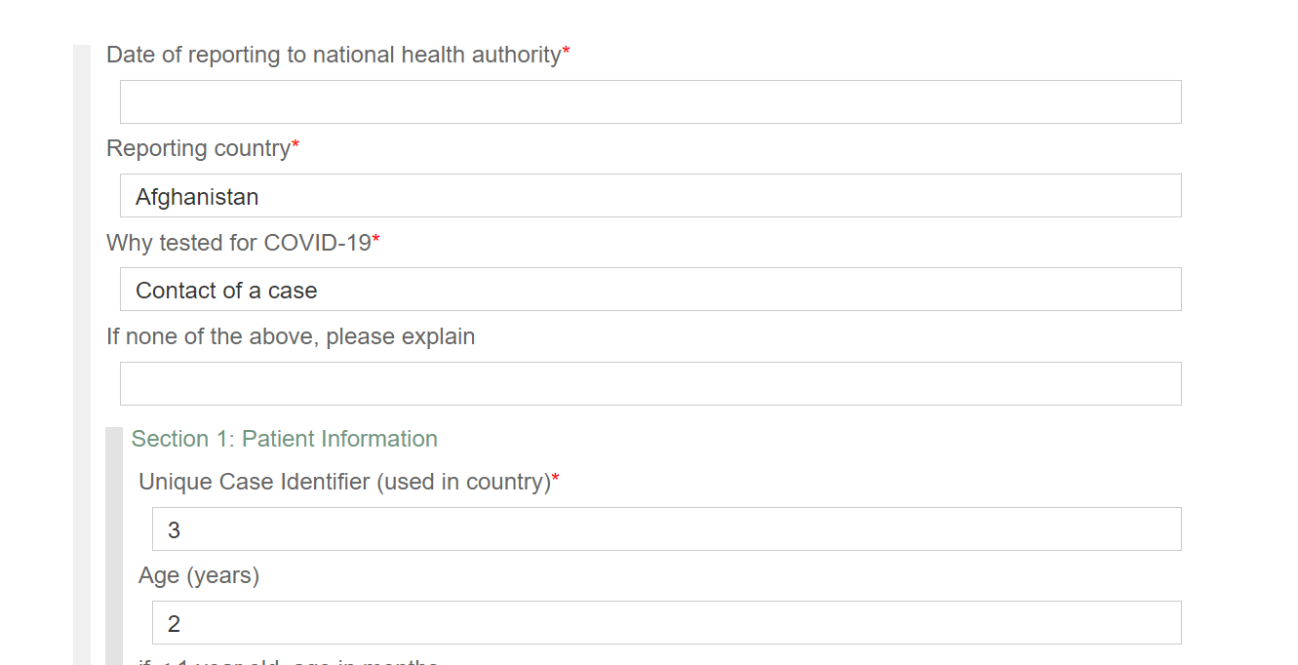
CEDAR 2: View
Examine a metadata form isntance ‘revised case report’
Link
Notes:
We can View. Search ‘revise case report`
You can see the emtadta instance dispalys like a form with filled out fields. The form comes with expect conveniouences such as drop-down menuse with autocomplete, help text tos erach foe ach field. And type checks against the field types.
One convenience tha tis not so typical and a key FAIR feature of CEDAR is the ability to examine the produced metadata in multiple formats. While this is not useful for domain expertist… for the FAIR technologists responsible for engineering this is extremely useful. You can view the native metadata in json-ld or the same information presented in RDF.
Looking at the JSON-ld we can see meatdata about the metadta. This ensure that this is a FAIR and machine actionable artifact.
When we exit the view we can view the artifact metadata. If we have permissions we can change various things https://cedar.metadatacenter.org/instances/edit/https://repo.metadatacenter.org/template-instances/95f57e08-138d-4762-9eb6-6243c9333e91?folderId=https:%2F%2Frepo.metadatacenter.org%2Ffolders%2F93769b83-f2ae-4a7d-a3a8-5a62afb4320c&search=revised%20case%20report&t=1688054078261

Slide 11
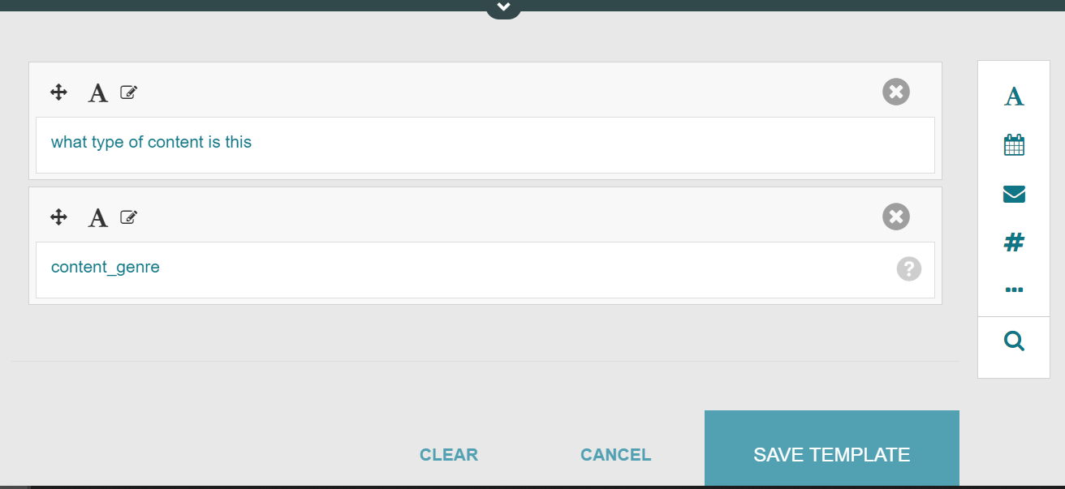
CEDAR 3: Build and test forms
Link
Notes:
If you want to build a template you can start by copying an existing one.
But for practice purposes you can very quickly start generating a blank form to get used to working with cedar.
First lets go into a folder where we want to make a form. /All / Users / Ran Li / Summer Institute Course 2023
Click New > Template. Cedar will open blank template for you to start filling out. Click save often.
Now create a few fields perhaps some metadata attributes you would like to collect. For now we own’t worry about controlled vocabularies and ontologies we will cover that soon. For now the goal is just to get used to UI/UX and see it is very similar to tools we current use (such as google forms).
Content type
Content metadata
After we are done we can click save. T
To test our form we can go and try out our form. We can pclick populate… CEDAR opens a new instance of this template in the metadata editor and you can start filling it out. Again you can view what your meatdata looks like at the bottom and once you save you can navigate back to see this istance. All / Users / Ran Li / Summer Institute Course 2023

Slide 12
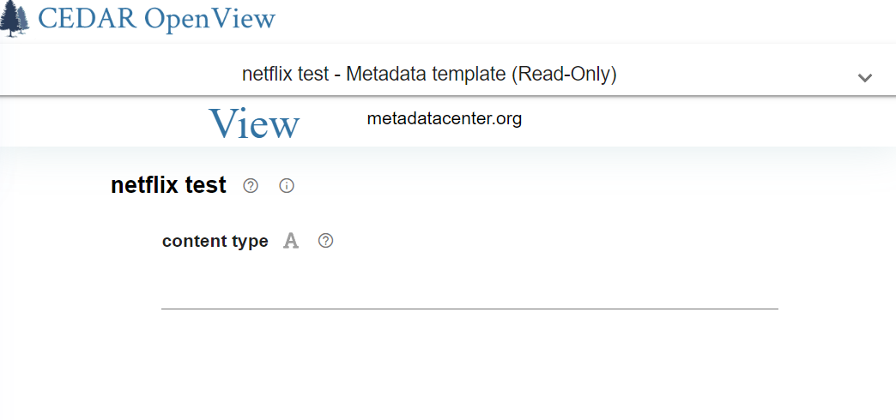
CEDAR 4: Share and OpenView
Link
Notes:
Earlier we showed a menu for changing the metadta instance. There are many useful aspects of this menu:
Share allows you to share with any person ro group you like with controlled previeleges.
Or you can make things completely open to internet with the open view setting. Use this for our test form.
After you have made it to open view you can click the open view. This goes the artifacts web page which is no visitbale to anyone on the web. The top center artifact name is an active link that shows metadata for this articact. And CEDAR users can click and jump back to your CEDAR account at anytime to make edits or anytime disable OpnView

Slide 13
CEDAR 5: Compose with elements
Link
Notes:
To make a template you can
create a new one and start adding dfields
or you can import fields that are already created e..g
If you want to reorganize your content; say fr presentation or reuse you can use elements (groups of fields)
We will use some elements form the another workshop (GOFAR M4m Deic Workshop > Demos and Examples > Longitude) to create a location elment and put that element in a template. CEDAR doesn’t have datatype for geospatial values like latitude and longitudiude. So we are composing them in a gneric way for this template.
Longitude element: If we look at the longitude element we it includes degress moutes and seconds of longitude any of which can be a float and another value for specifying east or west incase uses prefer that notfation.
We can create our own elements to reuse across templates. With new again we can reuse fields for example lets coperationze latitude. Insert arc second… and arc minute. We can reorder or modift as we see fit.

Slide 14
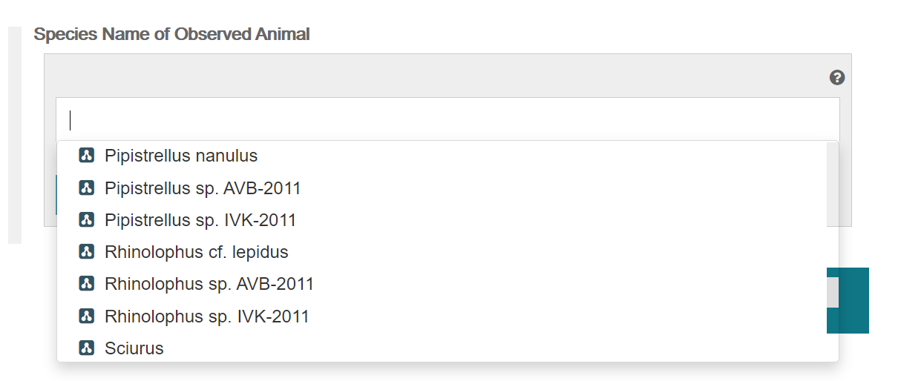
CEDAR 6: Semantics
Can use Bioportal as a way to implement machine actionable forms
Example: create a form that asks for species and Netflix content or genre
Notes:
If you have use the readio button or checkbox items in templates you know you can easily add values that strings. But these strings are not semantically and not interoperable with softwares even if they mean something to the human reader. To store something that is meaningful to a tranger or a machine we need to use the values tab of a text to select values that the users will see.
Field: Name: Taxonomis Identifier
## Ontology import
Preferred Label: Species Name of Observed Animal
Then click Click values > Add. As you watch CEDAR is searching for this term in the Bioportal ontology repository for occurrences of this search term. Seeing these returned values, we may not be sure if these are useful, so we can click on a term and click show details to see more information. You can check both the ontology details and the term details next to it. And on the left the hierarchy for which this term appears. If you do wnt this section you can lok for better matches. Or if you were not seeing high quality results you can enter a different search term.
You can pursue a completely different stratedge if you know what ontology you want to work with. Using the advanced settings by clicking the gear. You can search for an ontology or a term within an onotology. In this case what we can do is

Slide 15


Metadata: things not strings
Individuals: things, not strings
Things include:
ORCID for people
DOI for digital content
Benefits
Linked data
Get credit for the work you do
“ran” – wrote – “COVID manuscript”
https://orcid.org/0000-0002-4699-4755 - wrote - 10.2105/ajph.2021.306708
Notes:
Transitioning from our look a mappings within ontologies, there is one concept of FAIR emtadata we need to introduce before transitioning to metadata collection. we're discussing the concept of "Individuals: things, not strings". This principle emphasizes the importance of unique identifiers for individuals and digital content, rather than relying on names or titles that can be ambiguous or change over time.
When we talk about "things", we're referring to unique identifiers like ORCID for people and DOI for digital content. ORCID, or Open Researcher and Contributor ID, provides a unique, persistent identifier for researchers and scholars. This identifier is a 16-digit number that distinguishes individual researchers and ensures their work is correctly attributed. Similarly, a DOI, or Digital Object Identifier, is a unique alphanumeric string assigned to a digital object, such as a research paper, article, report, or dataset. This allows the object to be identified and accessed over the internet.
The benefits of using these unique identifiers are numerous. First and foremost, they enable linked data. Linked data is a method of structuring data to interlink related data across different documents or databases. This makes the data more useful and discoverable. For example, using an ORCID ID and a DOI, we can easily link a researcher to their published work.
Another major benefit is that these identifiers ensure you get credit for the work you do. In the academic and research world, it's crucial that your work is correctly attributed to you. Using unique identifiers like ORCID and DOI ensures this happens.
To illustrate this, let's consider an example. If a researcher writes a manuscript about COVID-19, we could describe this in a simple sentence like "ran – wrote – 'COVID manuscript'". But this doesn't provide much detail or context. However, if we use unique identifiers, we can provide a much more precise and useful description. For example, "https://orcid.org/0000-0002-4699-4755 - wrote - 10.2105/ajph.2021.306708". Here, we have the ORCID ID of the researcher, the action they took (writing), and the DOI of the manuscript they wrote. This clearly and unambiguously links the researcher to their work.

Slide 16
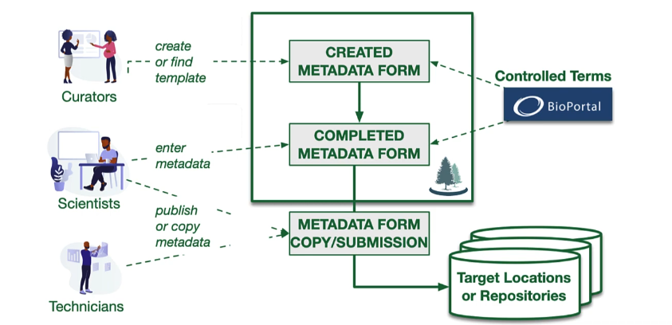
Making fair meta(data) with cedar
Steps:
Determing what metadata you want and create forms
Fill out forms
Export for use
FAIR features
Machine actionable
Integrates with FAIR controlled vocab + ontologies
Resusability
Ensure FAIR metadata during collection
Notes:
This big picture summary explains hwo CEDAR facilaitates FIAR metadata collection. There are three steps.
Create forms, fill forms and then view/transfer to target lcoaiton repository.
Step 1: To make a form you’ll decide what metdata your project wants to collect then ubild a form to collect hat metdata. In cedar we also calls these forms emtdata templates; you can resisuse artifacts or create by your self.
Step 2: your team members fill out forms and produce complete forms or what CEDAR acalls metadata instances. CEDAR makes sure entries are appropriate fo reach field and stores each completed form only people who have permission can see or modify.
Step 3: if you want to use the emtadta in another system you’ll copy or pblish the complete form to the place you want to use it. There are many ways to access metadta in CEDDAR such as via API or CEDAR can send meatdato many well-known external repositories.

Slide 17
Public Health ontology brain storm
Classes:
Represent concepts in a controlled vocabulary.
???
Individuals:
Represent instances of these concepts.
???
Relationships:
Represent instances of these concepts.
???
Notes:
Overall goal is to expose domain-experts to the tools to start learning, building and sharing ontologies. These tools include:
Bioportal (Repository for ontologies)
BioPortal is a powerful and widely utilized online platform for accessing and exploring biomedical ontologies and terminologies. Developed in Stanford and funded by both the NIH and NSF; this is the main repository for research currently. Started out as a biomedical ontology and that is its focus. Other domains such as public health don’t really have a robust ontology repository specific to this domain so for now most people just use bioportal
Protégé (Software for working with ontologies)
Protege is a popular open source software tool for working with ontologies, developed by the Stanford Center for Biomedical Informatics Research in collaboration with the Stanford University School of Medicine. The project has received funding and support from various organizations, including the National Institutes of Health (NIH), the National Science Foundation (NSF), and the European Union. It contu

Slide 18
Case Use: Leverage Bioportal ontologies
Can use Bioportal + CEDAR to streamline FAIR metadata collection
Example froms:
Species input
Content input
Notes:
If you use radio button or checkboxes. You can store values in strings but they are not very semantically meaningful or interoperble for software and linked data settings. Even if they mean something to the human user. To store something that is meaningful to a tranger or a machine we need to use the values tab of a text to select values that the users will see.
Field: Name: Taxonomis Identifier
Preferred Label: Species Name of Observed Animal
Then click Click values > Add. As you watch CEDAR is searching for this term in the Bioportal ontology repository for occurrences of this search term. Seeing these returned values, we may not be sure if these are useful, so we can click on a term and click show details to see more information. You can check both the ontology details and the term details next to it. And on the left the hierarchy for which this term appears. If you do wnt this section you can lok for better matches. Or if you were not seeing high quality results you can enter a different search term.
You can pursue a completely different stratedge if you know what ontology you want to work with. Using the advanced settings by clicking the gear. You can search for an ontology or a term within an onotology. In this case what we can do is search for homo sapien which si the human species. We can search for the onology For example source NCBITAXON-GNA. When can then choose what the scope of terms to add… ontology, branch or term. What we can do is just scroll up to hierarchy leel which aptures what we want and select to add.
We can see that now our form/template has change. CEDAR has automateically brought in that information we wanted and populated the form not with text but with things!(see JSON Schema below).
Improtalty to check that this worked we can click save and try to fill out the form

Slide 19
Roadmap
Intro - Big Picture - 6/26
Define FAIR meta(data) – 6/27
Define FAIR meta(data) – 6/28
Collect/Utilize FAIR meta(data) – 6/29
Putting it all together in a DMS/DMP – 6/30

Slide 20
Thanks!

